Slide 1
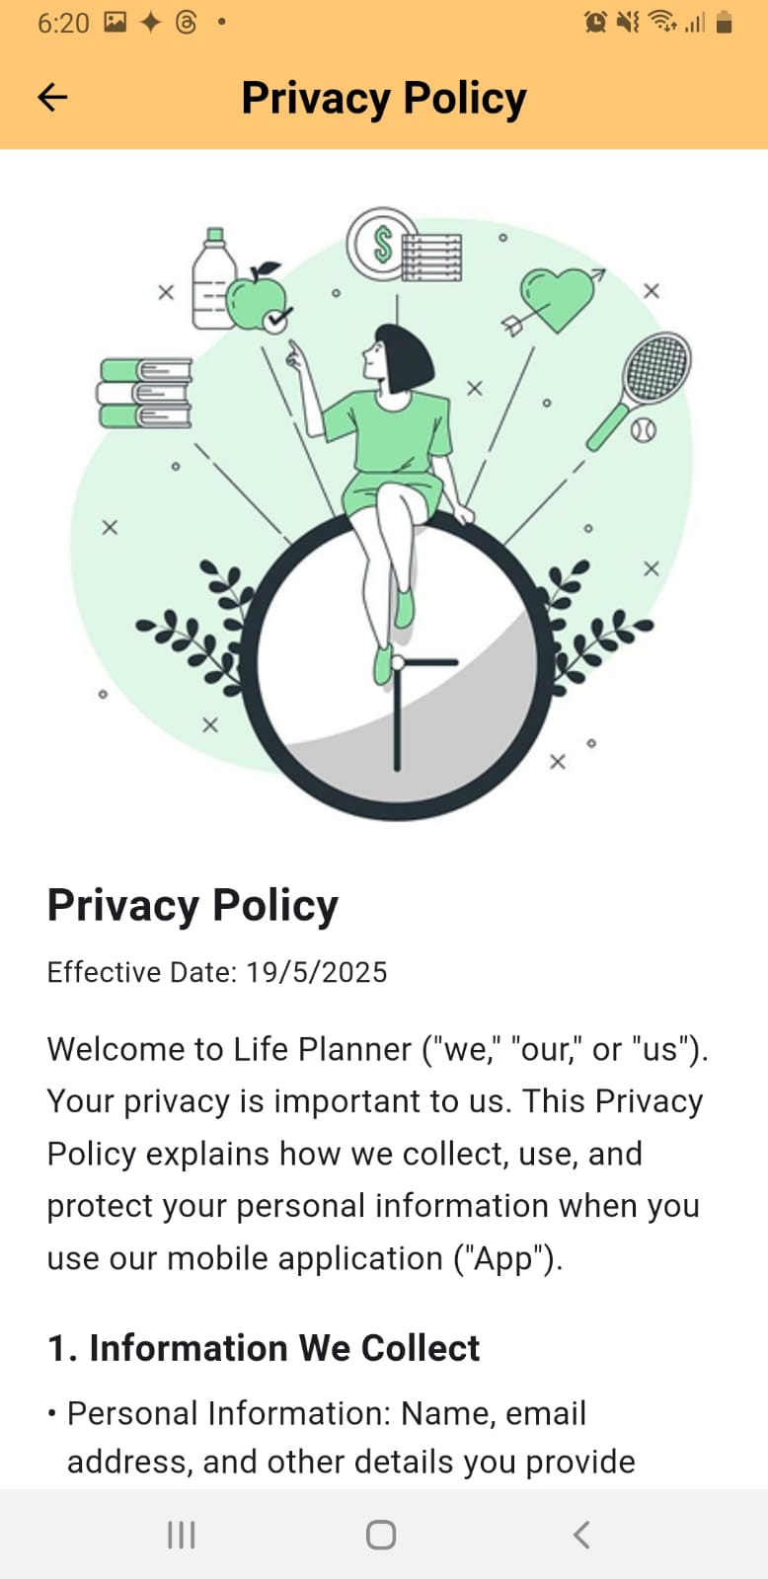
LIFE PLANNER
All-in-one planner for everyday life.
Course: CSCI490- Information System Development
Student Name: Hiba Shaito 42230627
Presented to:
Dr. Mohammad Jaafar Nehme
Institution & Date: Bachelor of Computer Science Lebanese International University–2024/2025
LIU
Hiba Shaito

Slide 2
Table of Content
Introduction/Objective of the project
Conclusion
Future work

Slide 3
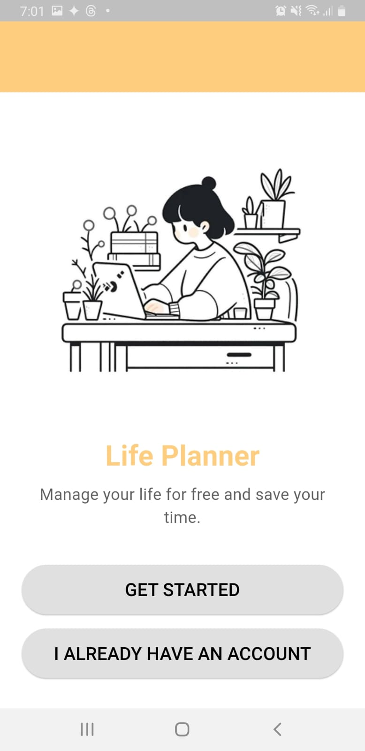
Objective of the Project
To design and develop a user-friendly mobile application that helps individuals efficiently plan and manage their daily life activities including:
Task scheduling and reminders
Health tracking (mood, water intake, notes)
Financial tracking
Note tacking
AI-powered Chabot for smart interactions
Seamless offline support and cloud synchronization
Friendly quotes and weather reporting

Slide 4

Conclusion
Developed a functional and user-friendly Life Planner app using Flutter and Firebase
Integrated key features: task scheduling, health tracking, note-taking, and finance management Integrated key features: task scheduling, health tracking, note-taking, and finance management
Ensured offline functionality and basic AI Chabot support using open tools
UI and UX focused on simplicity, accessibility, and daily usability

Slide 5
Future Work
Integrate NLP (e.g., Wit.ai) for advanced task management
Improve App Optimization to reduce resource usage and improve responsiveness
Use More Robust APIs and Services once budget allows, for better AI, analytics, and storage
Add More Calendar Views for better visualization of tasks and health logs
Advanced Notifications: Add snooze, priority levels, repeat rules, and smart alerts
Theme Customization: Offer light/dark modes and user-selected themes
Data Export and Backup Options (e.g., PDF, cloud sync)
Expand Platform Support to iOS and prepare for Play Store release
Cross-Device Sync: Improve real-time sync across multiple devices
Multi-language Support: Make the app accessible to non-English speakers
Unit & Widget Testing: Improve reliability with automated test coverage
Premium Features for Monetization: Advanced analytics & insights (e.g., spending trends, mood graphs), Exclusive themes and layout options, Ad-free experience, Priority customer support

Slide 6

Thank You
Hiba Shaito
42230627@students.liu.edu.lb

